Slide 1
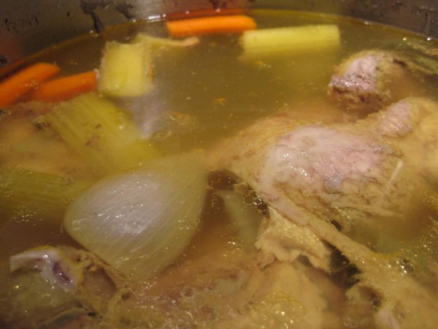
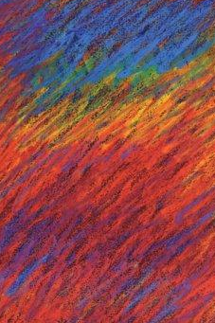
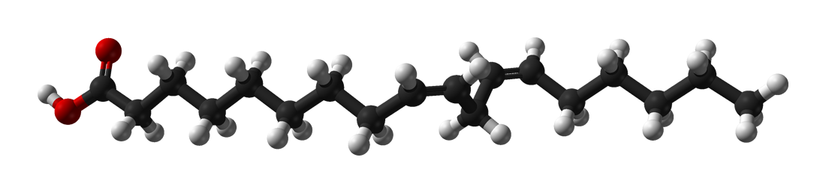
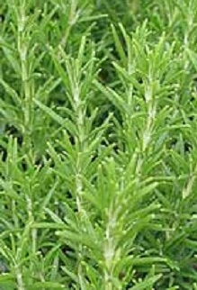
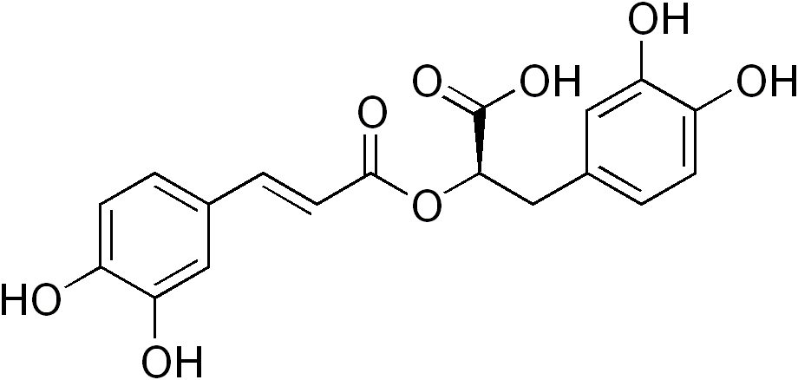
CHEM 450/450G
Fall, 2018 – Dr. M. J. Nee
Lecture II-9
Review of Equilibrium and Solutions
Plan for Today:
Chapter Reviews
Question and Answer
Soup

Slide 2
Chapter 6: Equilibrium
Use Gibbs and Helmholtz energy to determine maximum work and spontaneity in pure component systems
Use the Maxwell relations to connect thermodynamic parameters to one another
Predict temperature dependence of Gibbs Energy using the Gibbs-Helmholtz equation.
Define and use chemical potential to describe the effects of pressure, temperature, and composition on phases.
Explain the connection (and origins) between ΔG_{R} and K_{P}, and its relationship to LeChâtelier’s principle
Separate the contributions of extent of reaction(ξ)/ΔG_{r}º from the inherent effects of ΔG_{mixing} on the equilibrium constant.

Slide 3
Chapter 8: Phase Change
Interpret plots of μ(T), and how they vary with P with respect to different phases and their internal equilibria.
Predict changes in molar entropy and molar volume from slope of phase diagram using the Clapeyron equation.
Use the phase rule to place limits on possible phase equilibria.
Explain Critical point and supercritical fluids.
Calculate Gibbs energy and entropy of phase changes from enthalpy of sublimation, vaporization, fusion.
Determine enthalpy of formation using the Clausius-Clapeyron Equation.
Distinguish between vapor pressure and external applied pressure.
Describe surface tension and its effects quantitatively.

Slide 4
Chapter 9: Solutions (Ideal)
Describe ideal solutions with Raoult’s and Henry’s Laws, and real solutions using a Raoult’s or Henry’s Law standard state.
Implement chemical potential to describe the driving force behnd a spontaneous solution process, including colligative properties.
Enumerate the properties of ideal solutions (such as ΔH_{mixing} and ΔV_{mixing} = 0).
Binary solutions and vapor pressure for ideal solutions
Interpret or create from data a temperature-composition diagrams for ideal solutions that follows the phase rule.
Use the Gibbs-Duhem equation to describe the composition dependence of chemical potential
Outline the origin of colligative properties, but be able to calculate precisely the expected effect of solute on vapor pressure, freezing temperature, boiling temperature, and osmotic pressure.

Slide 5
Chapters 9: Solutions (non-ideal)
Identify real solutions based on differences in the A-A/B-B interactions as compared to A-B interactions, and in terms of ΔH_{mixing} and ΔV_{mixing} ≠ 0.
Explain that partial molar quantities depend on composition for real solutions.
Use activity as an “effective” concentration with respect to Raoult’s Law and Henry’s Law standards
Demonstrate that equilibrium in solution is based on activities: pure liquid or solid substances are not included in the calculation of solution-phase equilibria (but they are included in ΔG_{R})
Describe azeotropes and partially miscible solutions qualitatively.

Slide 6
Chapter 10: Electrolyte Solutions
Calculate the mean ionic molality, activity, and chemical potential given the mean ionic activity coefficient for a solution.
For a particular solution, determine the ionic strength for the solution.
Use ionic strength to determine mean ionic activity coefficient using Debye-Huckel theory.
Use ionic activity in the context of an equilibrium calculation involving electrolytes to calculate the effect of ionic strength on equilibrium concentrations in solution.
Describe the salting-in and salting-out effect in terms of K_{sp} and the Davies equation.

Slide 7
General questions before we start really cooking?

Slide 8
Soup
Making Soup:
Boil chicken with vegetables and herbs
Throw out mushy vegetables and spent herbs
Add fresh vegetables and chicken, return to boil, add noodles, cook until tender
Cool, skim fat
Freeze leftovers

Slide 9
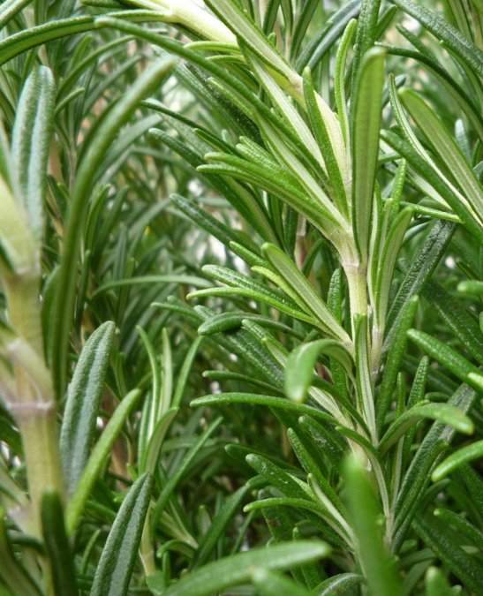
Equilibrium and chemical potential
The tasty parts of vegetables and herbs are often not very water soluble... what does this mean for their chemical potentials in different solvents?
How could we predict that?
Why does this change with heat?
rosmarinic acid

Slide 10
Henry’s and Raoult’s Laws
I like making soup because:
It warms and hydrates my house
It smells good
Which law would be most appropriate to model each of these effects?
Could I make soup without heat? Would it accomplish goals 1 and 2?
What if I wanted to oxygenate my soup? Hot or cold and why?

Slide 11
Partially miscible solutions
Chicken Fat is approximately 20% linoleic acid
Water-linoleic acid is not an ideal solution. What are the thermodynamic parameters associated with mixing? What is the sign of each?

Slide 12
Real Solutions: Standard States
Chicken Fat is approximately 20% linoleic acid
What experiment could I do to measure the activities of the fat and the water in my soup?

Slide 13
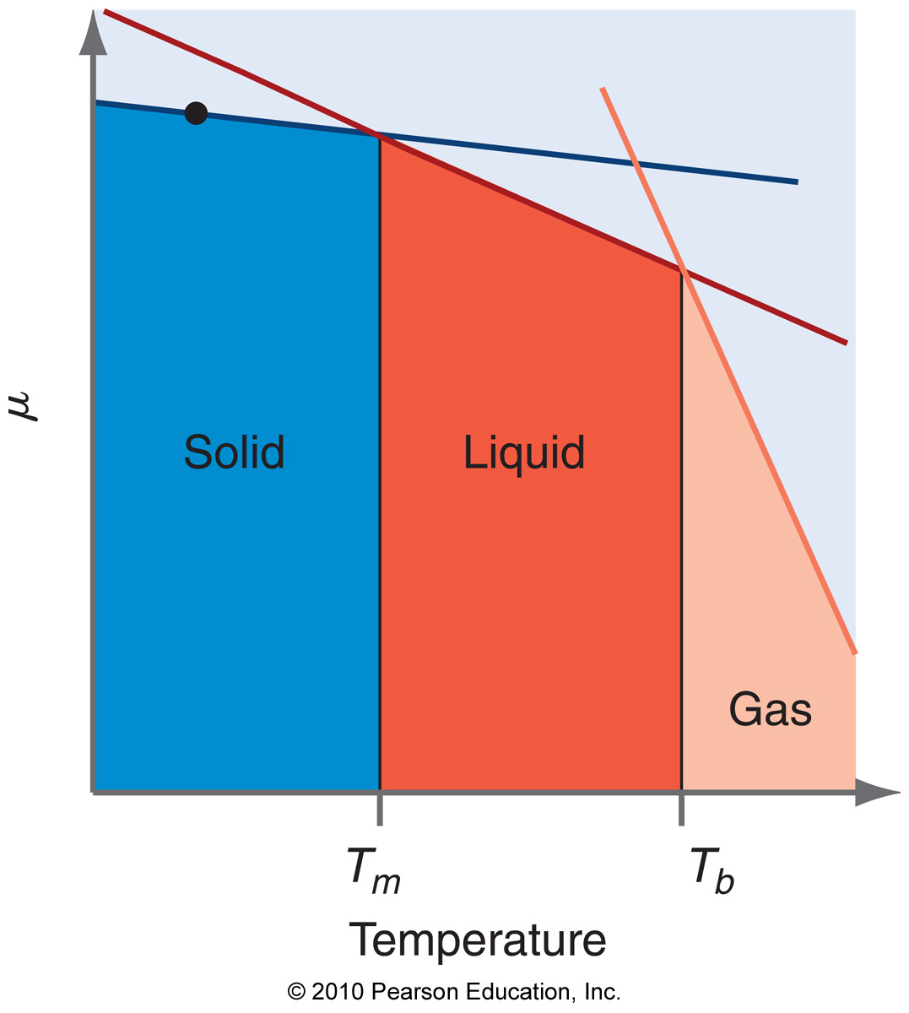
Colligative properties
Aside from the salt, there are a lot of other solutes in the mixture. How do we account for the presence of multiple solutes in terms of the colligative properties?

Slide 14
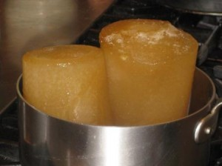
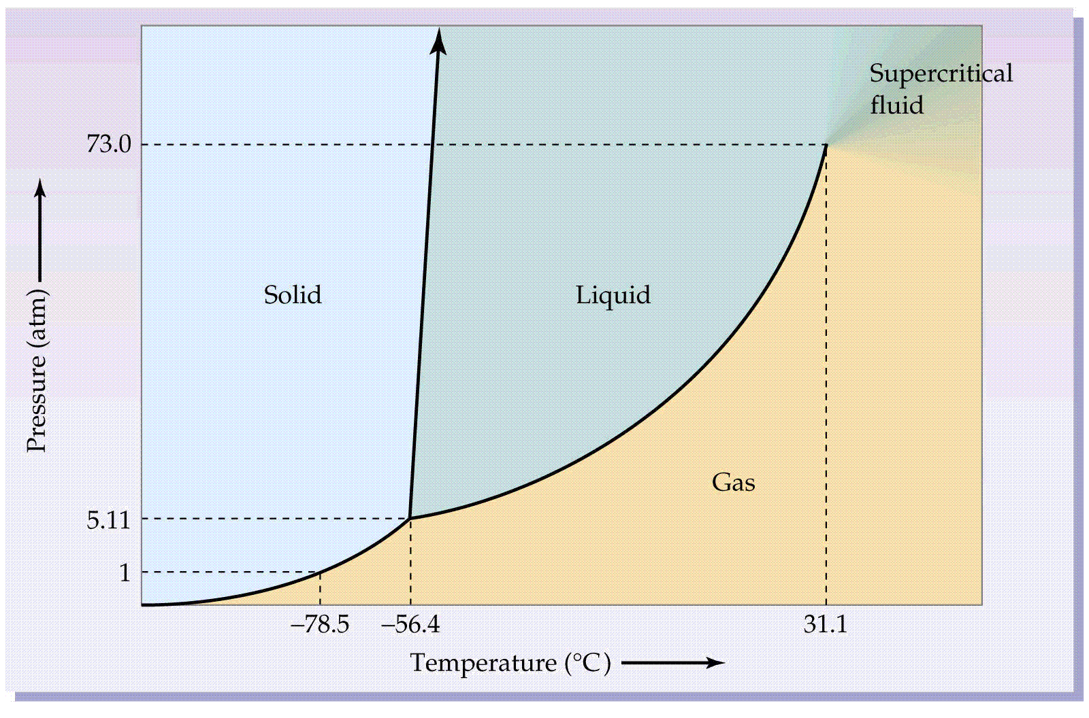
Phase Change
1. When I freeze my broth, before I use it again, I have to thaw it completely before testing the salt level. The outer most part is not nearly as salty as the inner part. Why is that?
2. What would be the implication of trying to freeze soup made of CO₂ instead of water? Does the sign of matter?

Slide 15
Practice Exam solutions are up. Study, and ask questions as they come up.
As before, study the HW, get the concepts, and know the lingo – it isn’t about memorizing formulas, except for a small handful of important ones.

